Slide 1
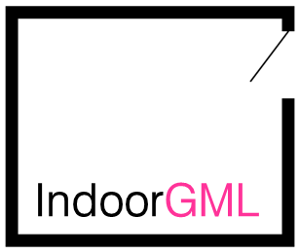
Linking IndoorGML with CityGML
June 21, 2013
Ki-Joune Li
Pusan National University

Slide 2
Agenda
Overview on IndoorGML
Linking IndoorGML with CityGML

Slide 3
IndoorGML as a Complement
CityGML
IndoorGML
1. Symbolic Space
+ Network and
2. Multi-Layered Space Model
KML
IFC
Indoor positioning and geometry are not main focus

Slide 4
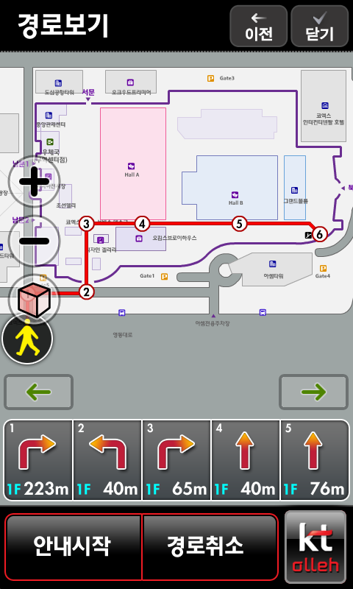
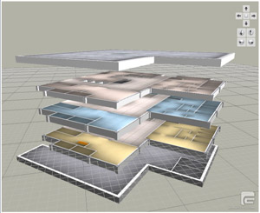
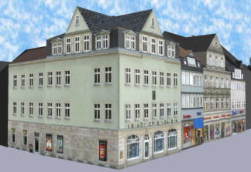
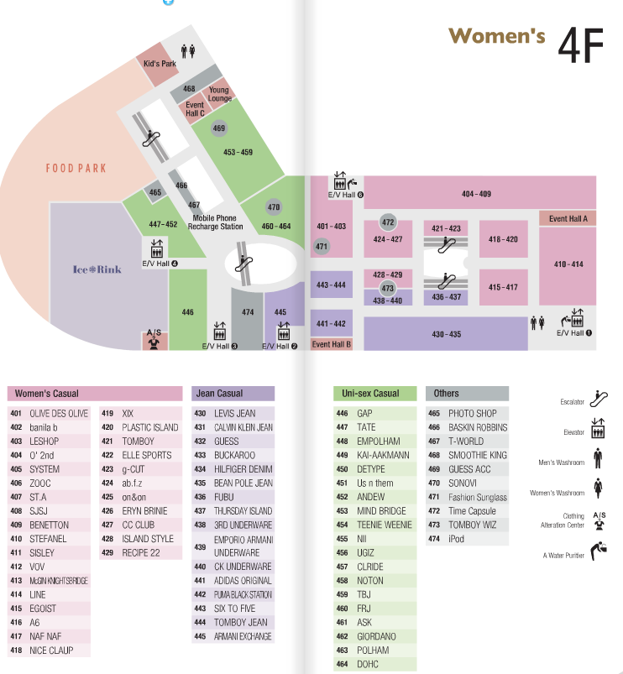
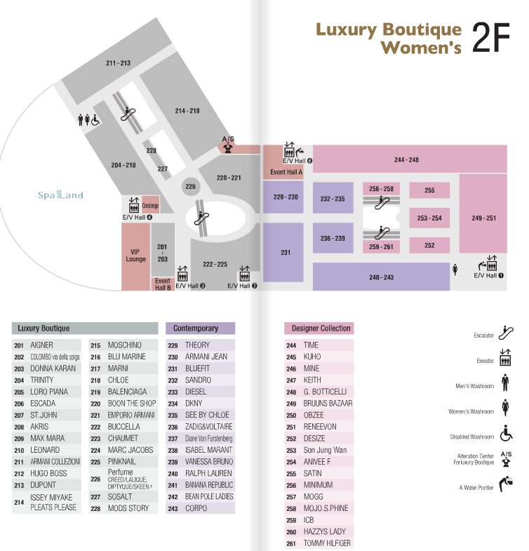
Combination of IndoorGML and others
Services for handicapped persons
Indoor LBS
IndoorGML
Derivation
Import
IFC
KML
Emergency Control
Application
CityGML
2D Indoor Floor Plan
Indoor Robot
Indoor mCommerce

Slide 5
IndoorGML is a Graph Model
Topology
IndoorGML
Symbolic Space and Geometric Graph
Standard for Geometric Graph
Multi-Layered Space Model
IFCxml
CityGML
KML
Multi-Level 2D
Image
Geometry

Slide 6
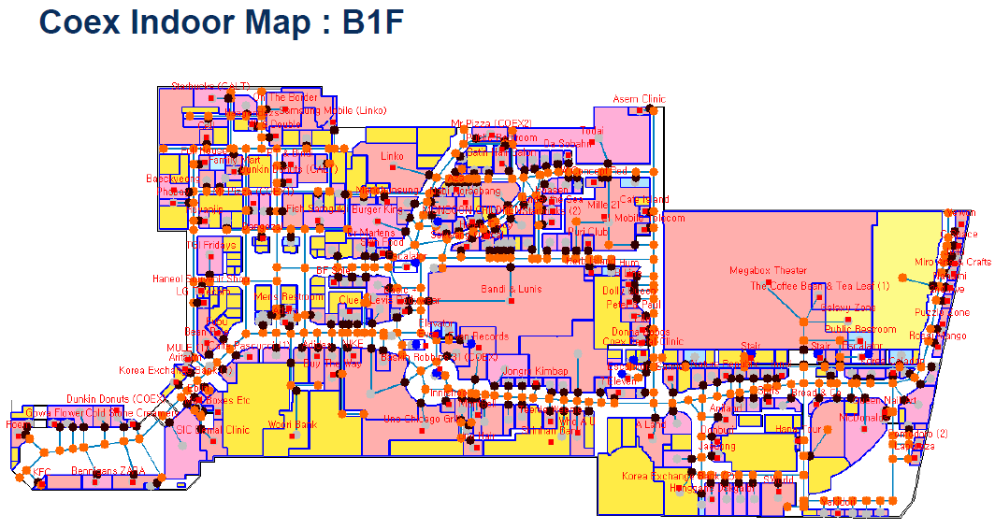
Geometric Graph
[D.K Suh, IndoorGML Workshop, Seoul, 2012]

Slide 7
Three ways to represent geometry
For detail geometric or semantic information of this space
External Objects
0..1
external Reference
0..1
Simplified Geometry
IndoorGML Core Module
gml::Solid
0..1
boundedBy
indoorGMLCore:: AbstractSpace
*
indoorGMLCore:: AbstractSpaceBoundary
0..1
gml::Surface
duality
0..1
duality
indoorGMLCore:: State
0..*
node
Graph of single layer
node
Geometric Graph
gml::Point
0..1
edge
indoorGMLCore:: SpaceLayer
indoorGMLCore:: Transition
0..*
gml::Curve
edge
0..1

Slide 8
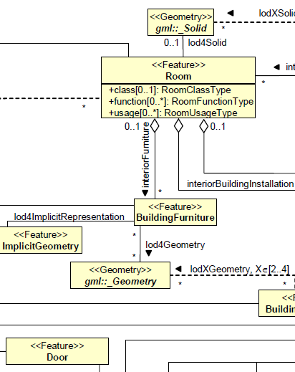
External Reference to CityGML Object
IndoorGML
indoorGMLCore:: AbstractSpace
indoorGMLNavi:: NavigableSpace
indoorGMLNavi:: TransferSpace
indoorGMLNavi:: GeneralSpace
(room)
indoorGMLNavi:: ConnectionSpace
(door)
gml::MultiSurface

Slide 9
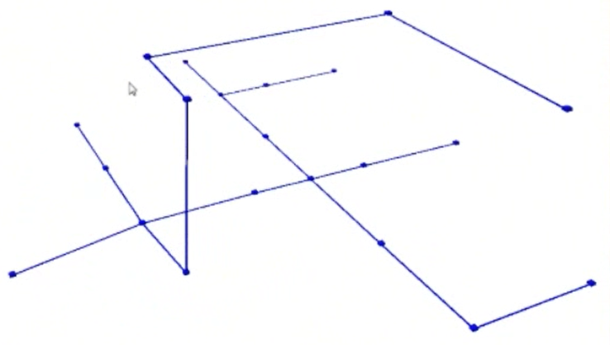
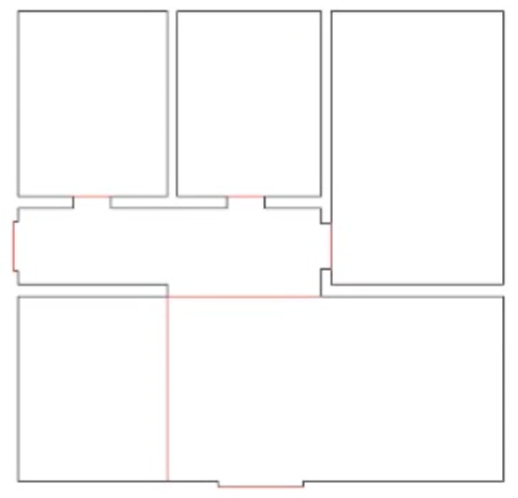
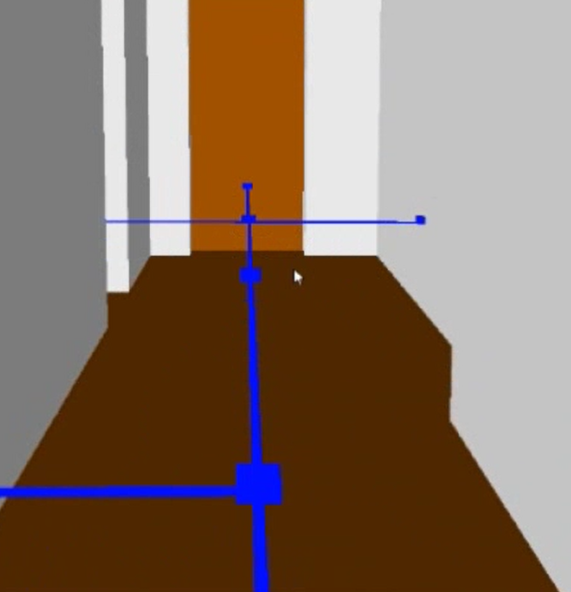
Linking IndoorGML with CityGML
IndoorGML
External Reference to room in CityGML
gml::id=001
0th Floor
1st Floor

Slide 10
Issues
Geometry
1:N mapping
Virtual Division
Synchronization

Slide 11
Geometry
In CityGML
Room: Solid or MultiSurface
Door: MultiSurface
In IndoorGML
Room: Solid in 3D (or Surface in 2D)
Door
→ The geometry mismatch doesn’t matter.
 | 3D space | 2D space (e.g. floor plan)
Thick Door | GeneralSpace: Solid ConnectionSpace: Solid | GeneralSpace: Surface ConnectionSpace: Surface
Thin Door | GeneralSpace: Solid ConnectionSpace: Surface | GeneralSpace: Surface ConnectionSpace: Curve

Slide 12
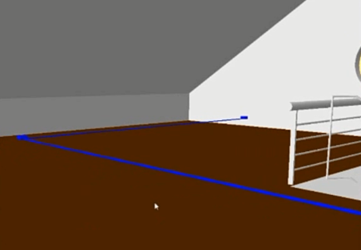
1:N mapping
IndoorGML
0th Floor
1st Floor
But Neither N:1 Nor N:M

Slide 13
Virtual Division
1st Floor
1st Floor
- ConnectionSpace in IndoorGML
- ClosureSurface in CityGML
* Door also belongs to ConnectionSpace in IndoorGML

Slide 14
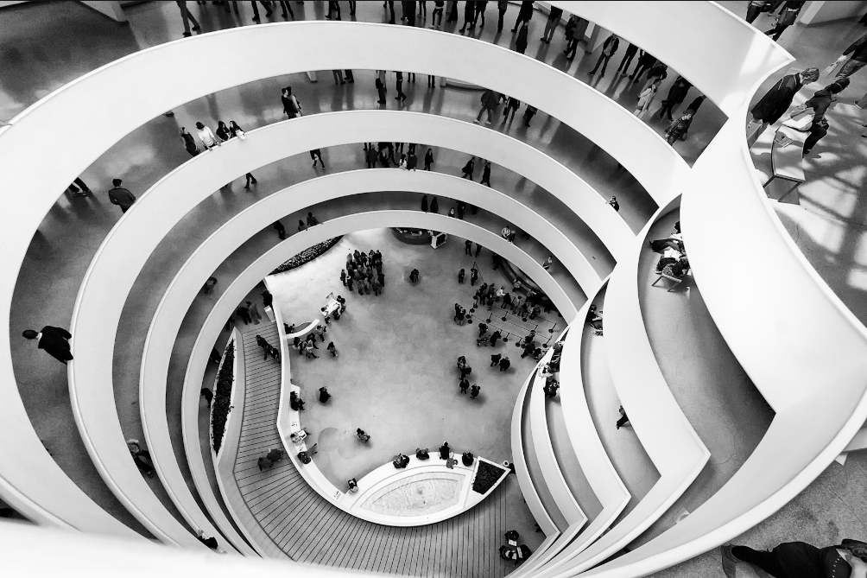
Virtual Division
How to divide this?
[Guggenheim Museum in Manhattan]

Slide 15
Summary
IndoorGML
A Graph Model
Provides a linkage with CityGML (and IFC as well) via external reference (xlink)
Issues
Geometry, 1:N Mapping, Virtual Division
Synchronization between CityGML and IndoorGML
Not a Data Model Issue but System Issue
Sample Data
Any CityGML LoD4 sample data is welcome

